Slide 1

DATA STRUCTURES AND ITS APPLICATIONS
Vandana M L
Department of Computer Science and Engineering

Slide 2

DATA STRUCTURES AND ITS APPLICATIONS
Introduction to Data Structures
Vandana M L
Department of Computer Science and Engineering

Slide 3
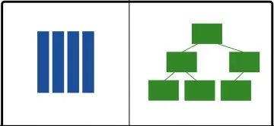
DATA STRUCTURES AND ITS APPLICATIONS
Introduction to Data Structures
Data Structure is a scheme of organizing data in the memory of the computer in such a way that various operations can be performed efficiently on this data

Slide 4


DATA STRUCTURES AND ITS APPLICATIONS
Introduction to Data Structures
Why Data Structure?

Slide 5


DATA STRUCTURES AND ITS APPLICATIONS
Introduction to Data Structures
Computer systems deal with large amount of data
( text ,image, relational data etc.)
Data is just the raw material for information, analytics, business intelligence, advertising, etc.
The way data is organized in memory plays a
key role in deciding the time complexity of the
algorithms designed for solving the problems
Data Structures and algorithm go hand in hand
Why Data Structures?
Hello!!!
I am Algorithm
Lets Crack this problem together
Hey !!!
I am Data Structure

Slide 6
DATA STRUCTURES AND ITS APPLICATIONS
Introduction to Data Structures
Importance of Data Structures
Data Structures is most fundamental and building block concept in computer science
Good knowledge of Data Structures is required to build efficient software systems

Slide 7
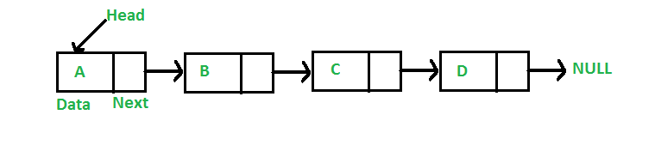

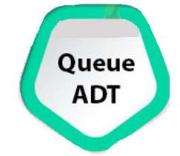



Data Structures and its Applications
Abstract Data Type
Abstract Data Type is used to represent data and operations associated with an entity from the point of view of user irrespective of implementation
ADT can be implemented using one or more Data Structures and Algorithms
.
Create
Push
Pop
Display
Destroy
Create
Insert
Delete
Display
Destroy
Search key
Create
Enqueue
Dequeue
Display
Destroy

Slide 8
DATA STRUCTURES AND ITS APPLICATIONS
Classification of Data Structures
Linear Data Structures
Stack, Queue, Linked List
Non Linear Data Structures
Tree , Graph

Slide 9

DATA STRUCTURES AND ITS APPLICATIONS
Classification of Data Structures : Linear Data Structures
Linear Organisation
Stack
Queue
Linked List
Linear List using Array

Slide 10
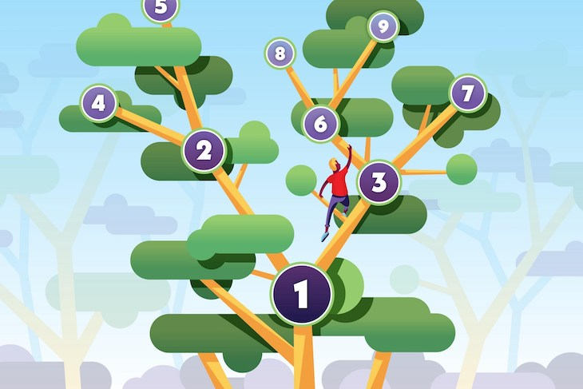
DATA STRUCTURES AND ITS APPLICATIONS
Classification of Data Structures : Non Linear Data Structures
Non Linear Organisation
Tree
Graph

Slide 11
DATA STRUCTURES AND ITS APPLICATIONS
Few Applications of Linear Data Structures
Array
To implement other data structures
To store files in memory
Linked Lists
To implement other data structures
To manipulate large numbers
Stacks
Recursion
Infix to postfix conversion
Queues
Process Scheduling
Event handling

Slide 12
DATA STRUCTURES AND ITS APPLICATIONS
Few Applications of Non Linear Data Structures
Tree
Auto complete features (Trie)
Used by operating systems to maintain the structure of a file system
Heaps
Priority Queue implementation
Heap Sort
Graphs
Computer Networks
Shortest Path Problems

Slide 13
Data Structures and Applications
Overview- Course Contents
Unit -1 : Overview
Recursion,
User defined data type,
pointers, pointer to structures,
Static and Dynamic Memory Allocation.
Linked List:
Doubly Linked List,
Circular Linked List – Single and Double,
Multi List: Introduction to sparse matrix (structure).
Skip list Case study: Dictionary implementation using skip list.

Slide 14
Data Structures and its Applications
Overview
Unit -2 : Stacks and Queues
Stacks: Basic structure of a Stack,
Implementation of a Stack using Arrays & Linked list.
Applications of Stack:
Recursion: Tower of Hanoi.
Conversion & Evaluation of an expression: Infix to postfix, Infix to prefix,
Evaluation of an Expression,
Matching of Parenthesis.

Slide 15
Data Structures and its Applications
Overview
Unit -2 : Stacks and Queues
Queues & DEQUE: Basic Structure of a Simple Queue,
Circular Queue,
Priority Queue,
DEQUE and its implementation using Arrays and Linked List.
Applications of Queue: Case Study – Josephus problem, CPU scheduling

Slide 16
Data Structures and Applications
Overview- Course Contents
Unit -3 : Trees and Heaps
Trees
Definitions, Binary Trees, Binary Search Tree, Threaded Binary trees.
Operations on Trees
Implementation of BST,
Threaded BST
Heaps
Heap as a Data Structure
Array Implementation
Priority queue as a heap
Applications : Dictionary Implementation

Slide 17
Data Structures and Applications
Overview- Course Contents
Unit -4 : Balanced Trees and Graphs
AVL Trees
Operations on AVL Trees
Properties of Graphs
Implementation of Graphs
Search Operations on Graph
Applications :
Indexing in data bases
Representing a Computer Topology

Slide 18
Data Structures and its Applications
Overview- Course Contents
Unit -5 : Suffix Trees
Tries
Implementation of Tries
Operations on Tries : Insert, delete and search
Applications :
Word Prediction
URLs Decoding
Cryptography
Unit -5 : Hashing
Hashing Techniques
Collision resolution
Double Hashing, Rehashing

Slide 19
Data Structures and its Applications
Overview- Course Contents
Text Book :
Data Structures using C & C++
Yedidyah Langsam, Moshe J. Augenstein, Aaron M. Tenenbaum, 2015, Pearson Education , 2nd Edition.
Reference Book:
Data Structure and Program Design in C
Robert Kruse, C.L Tondo, Bruce P. Leung – 2007, Pearson Education ,2nd Edition.

Slide 20
Data Structures and its Applications
Overview- Course Contents
Updation
ISA Component | Description | Total Marks
ISA | Best 4 out of 5 | 30
Hands-on / Lab | 10 Labs | 10
Assignment | 3 assignments | 10
Practice problems | 10 sessions
Total ISA Marks |  | 50
1)10 marks for each session totalling 100 marks for10 lab sessions.
2) Each lab session needs to be evaluated for 10 Marks.
Submission within the lab hours will be evaluated for 10 marks.
Late submissions on the same day will be evaluated for 8 marks.
Late submissions on the next day till next week will be evaluated for 5 marks.
Submissions later than a week will be evaluated for 2 marks.
3. Submission has to be a .c file or .pdf file with the c code copy pasted along with the output screenshot (to be discussed).
File to be named SRN_LabNo
4) Submissions may be taken on Edmodo/MS teams/Google form as per faculty convenience .

Slide 21
THANK YOU
Vandana M L
Department of Computer Science & Engineering
vandanamd@pes.edu
+91 7411716615

